Slide 1
Tata Data Visualization
Empowering Business with Effective Insights virtual experience program

Slide 2
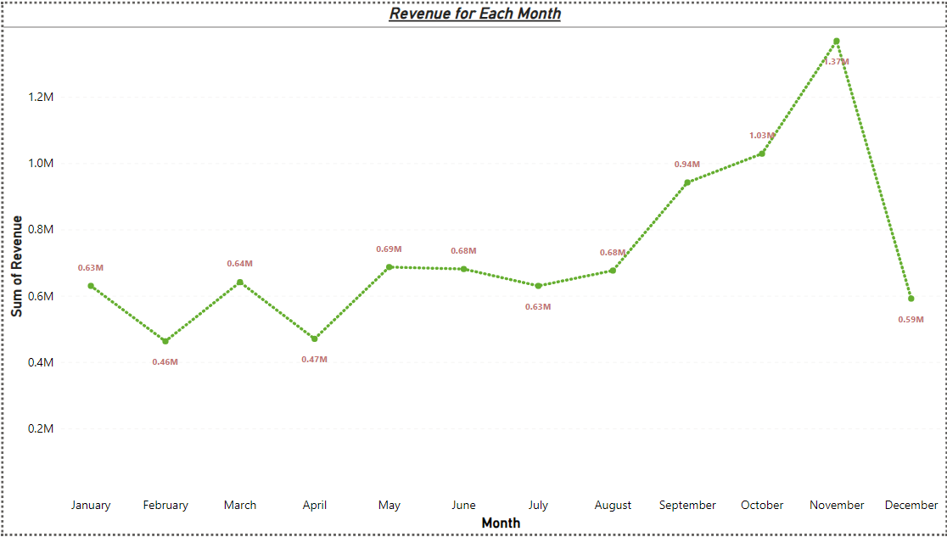
Question.1

Slide 3
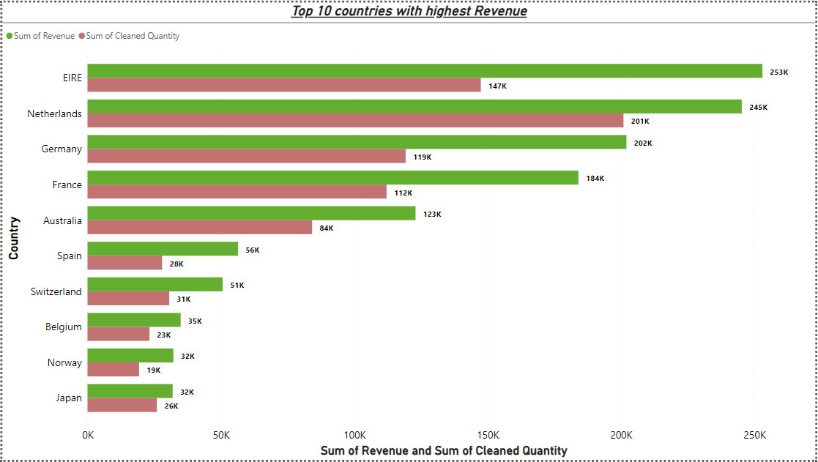
Question.2

Slide 4
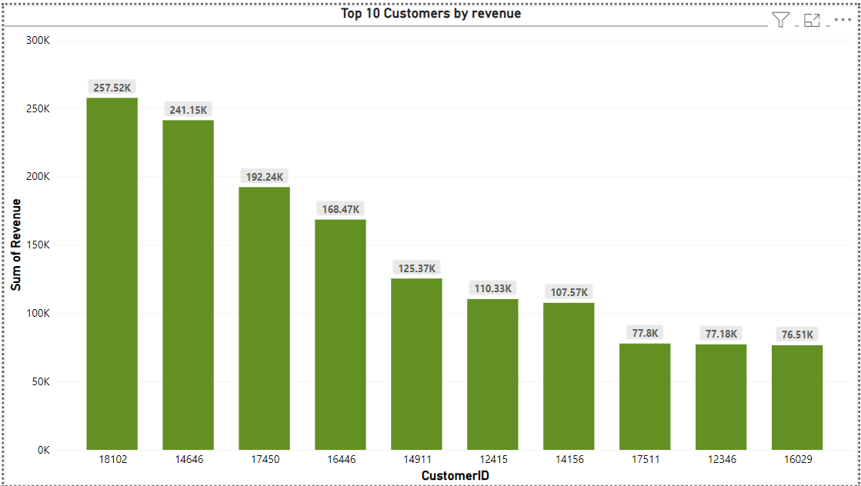
Question.3

Slide 5
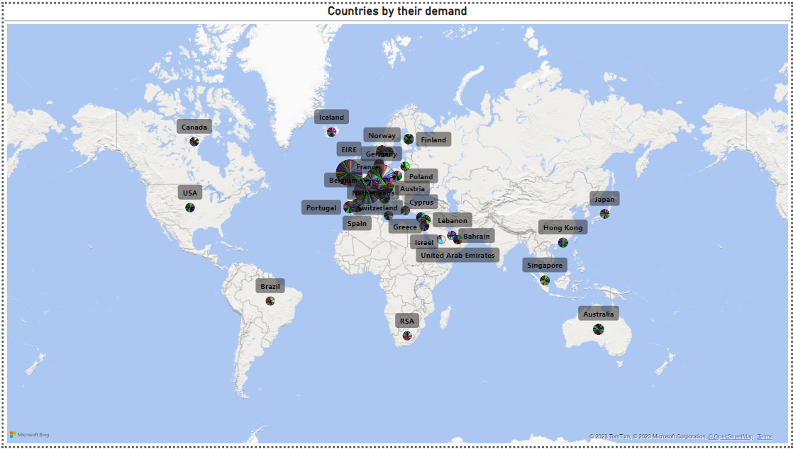
Question.4

